Slide 1
New Voices. New Voters. New Mexico.

Slide 2
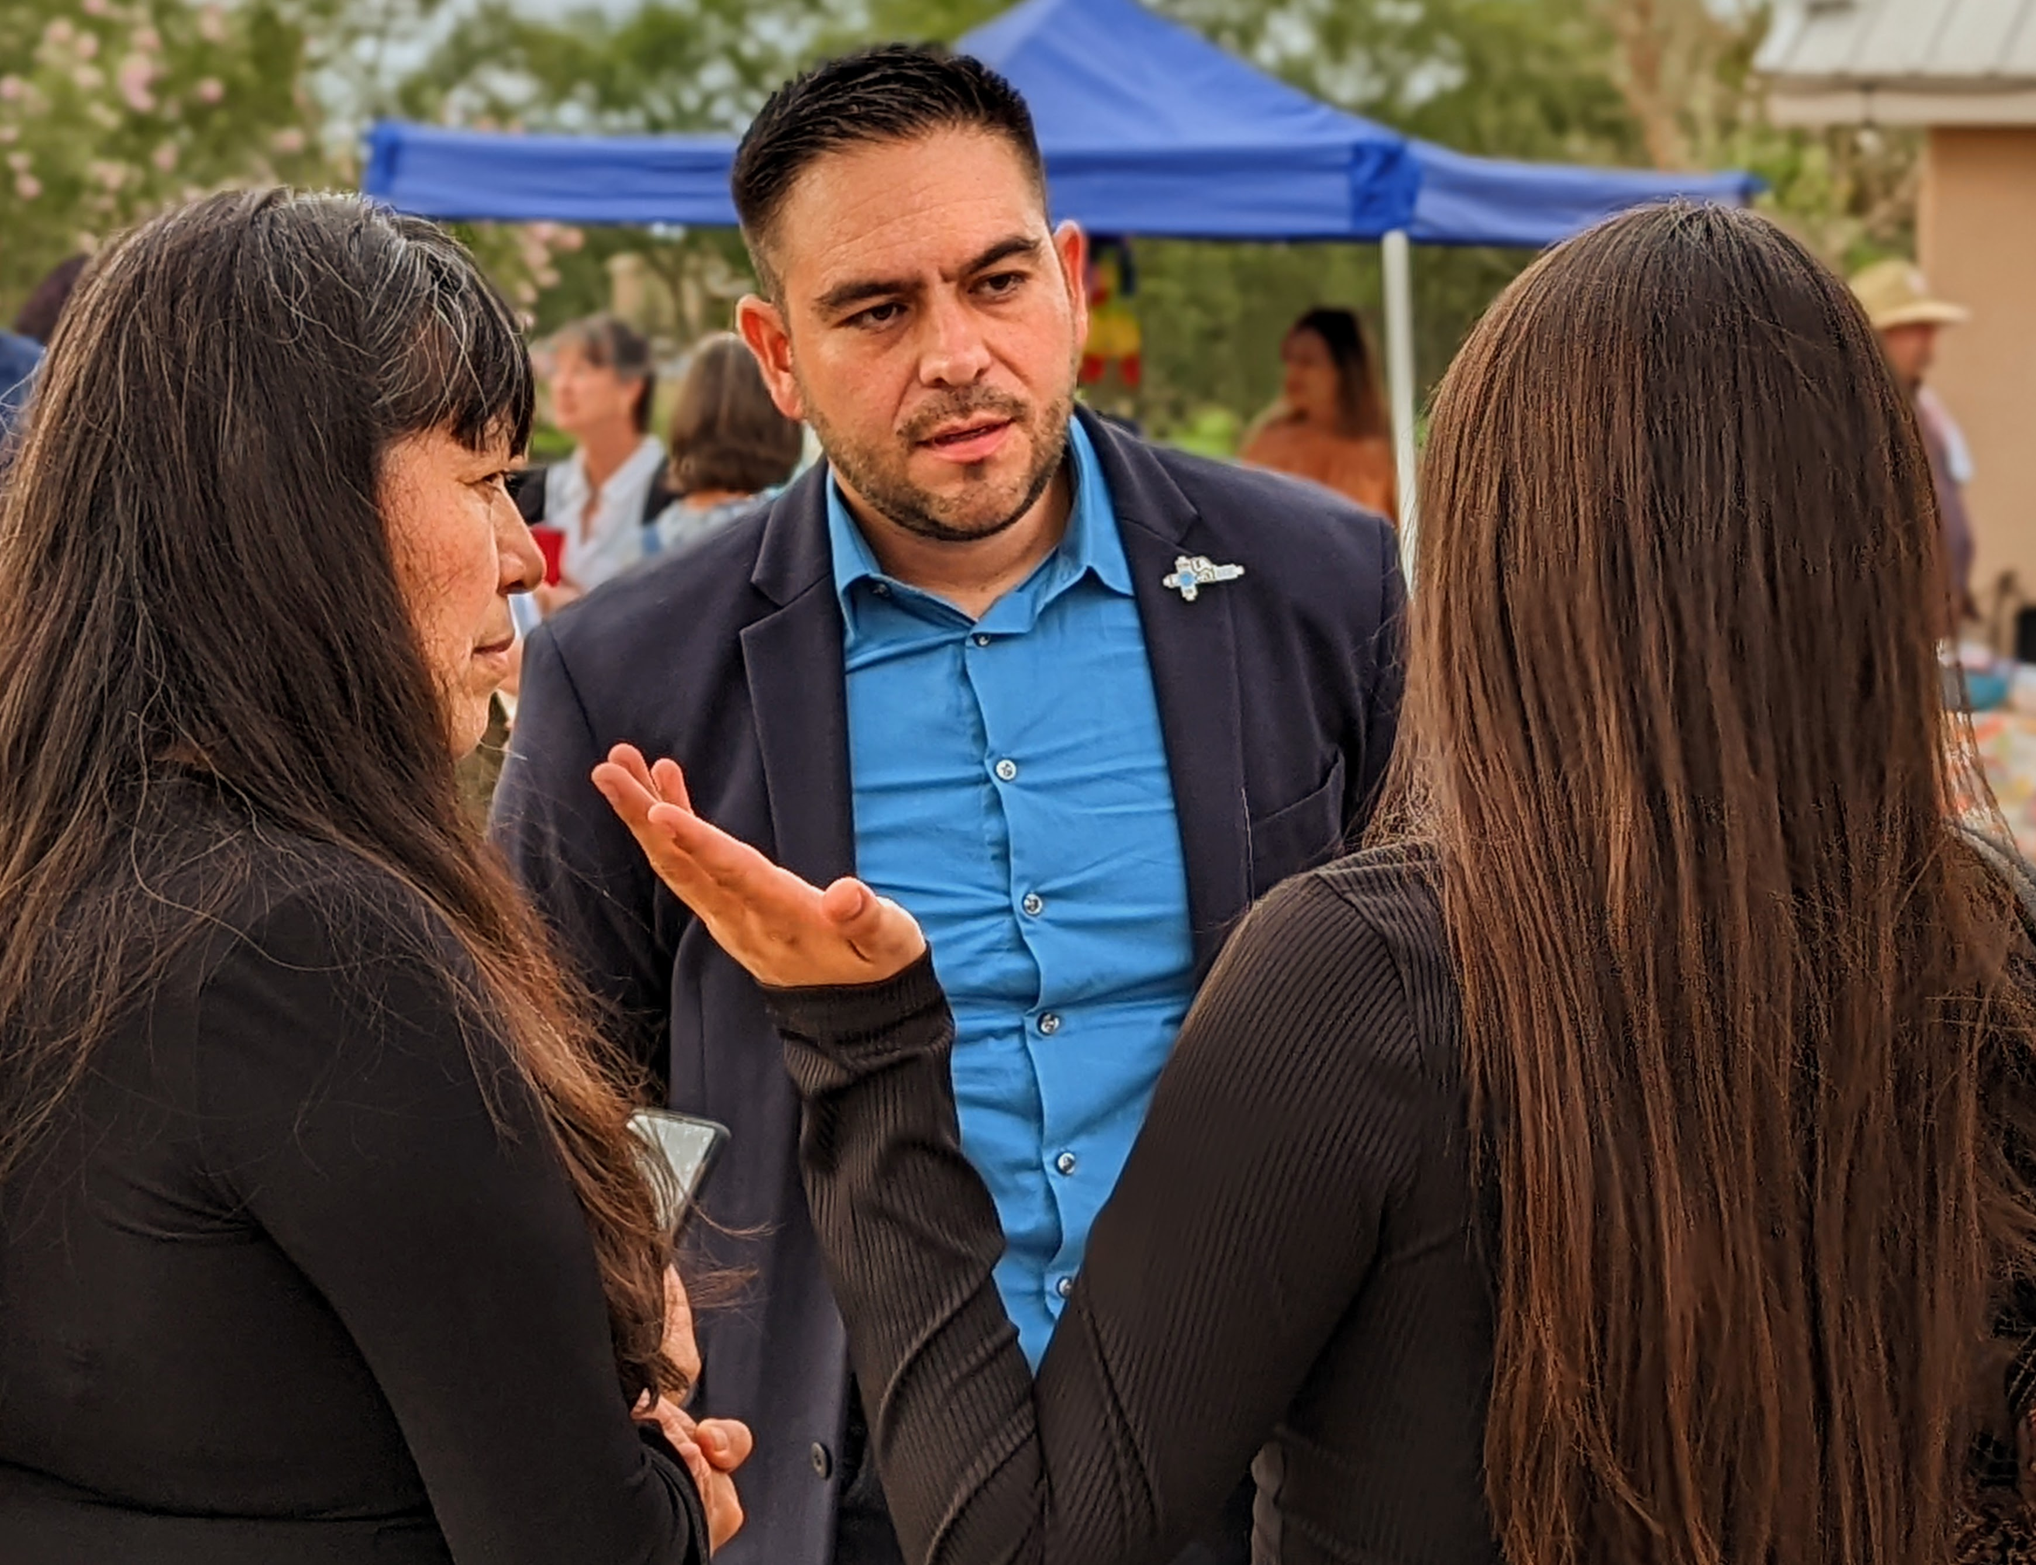
We helped elect Rep. Gabe Vasquez. Now we want to re-elect him.

Slide 3
Let’s look at his record so far.

Slide 4
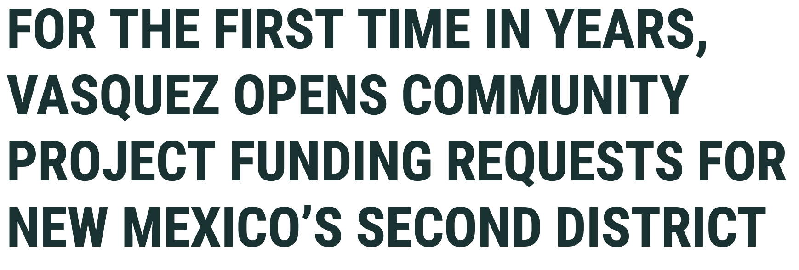
Community Project Funding Proposals
*
Press release
March 8, 2023
Press release
April 24, 2023
*Yvette Herrell accepted no Community Project Funding requests during her term (2020-2022).

Slide 5
Doña Ana County funding proposals
New street lights, ramps & sidewalks ($1M)
Renovating a facility for after-school activities ($3M)
Permanent food
pantry in Hatch ($300K)

Slide 6
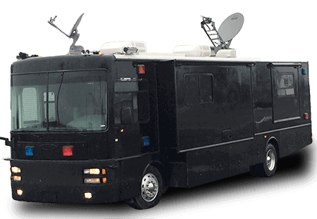
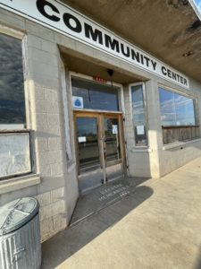
Luna County & Hidalgo County
Wastewater treatment facility ($500K)
Luna Co. Mobile Command Center ($950K)
Public
Safety
Renovation of Lordsburg Community Center ($2M)

Slide 7
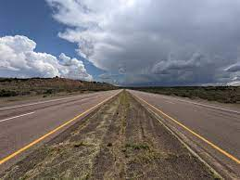
Grant County
for wastewater system improvements ($5M)
To NM DOT for I-10 improvement along a 9-mile stretch outside of Silver City ($5M)
Construction of a new Gila Community Center, after the old one closed ($400K)

Slide 8
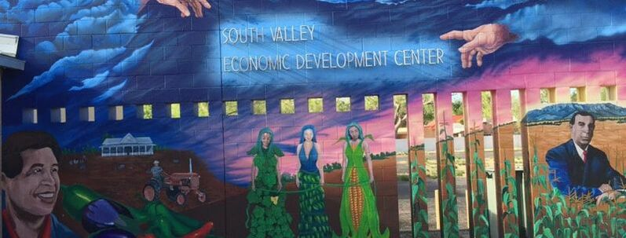
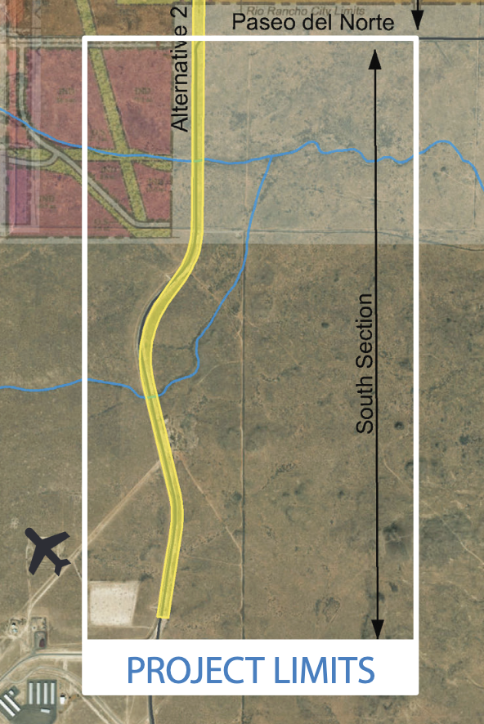
Bernalillo County’s South Valley
New agricultural economic development center ($4M)
Reconstructing a 2 mile stretch of Atrisco Blvd. that could bring
13,000 jobs to the area. ($4M)

Slide 9
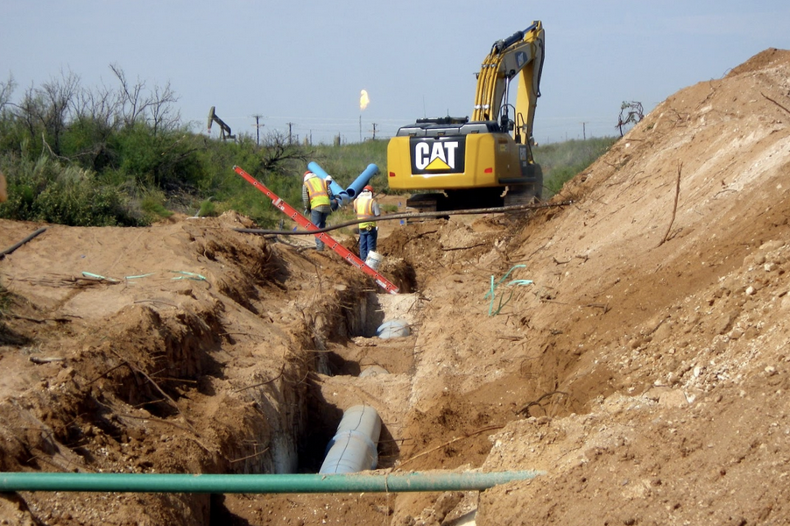
Water in Eddy County
To replace water lines in an oil well field that is losing 12 million gallons of water per year. ($2M)
A decades-long project to allow the City of Carlsbad to grow and thrive in a desert environment

Slide 10
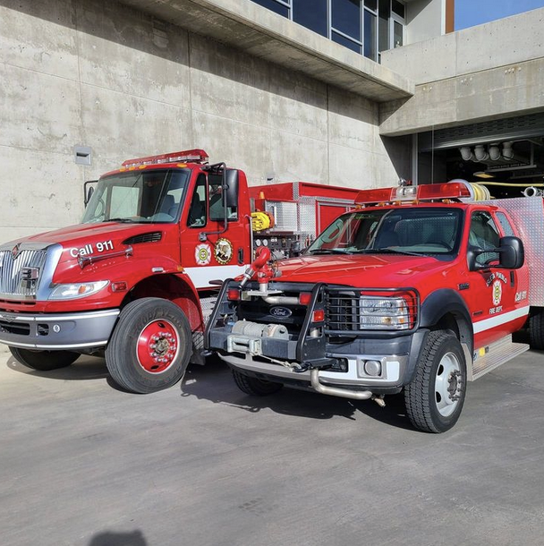
Emergency Protection
VALENCIA COUNTY
Isleta Pueblo
New fire protection vehicle ($900K)
Public
Safety
SIERRA COUNTY
Emergency Operations Center
($2,625,000)

Slide 11
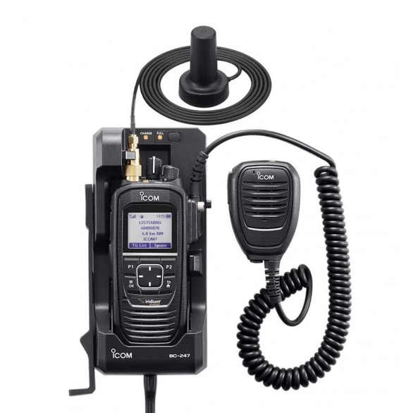
Public Safety
Handheld radios and
satellite communication technology to help improve
law enforcement communication in rural communities. ($800K)
Public
Safety

Slide 12
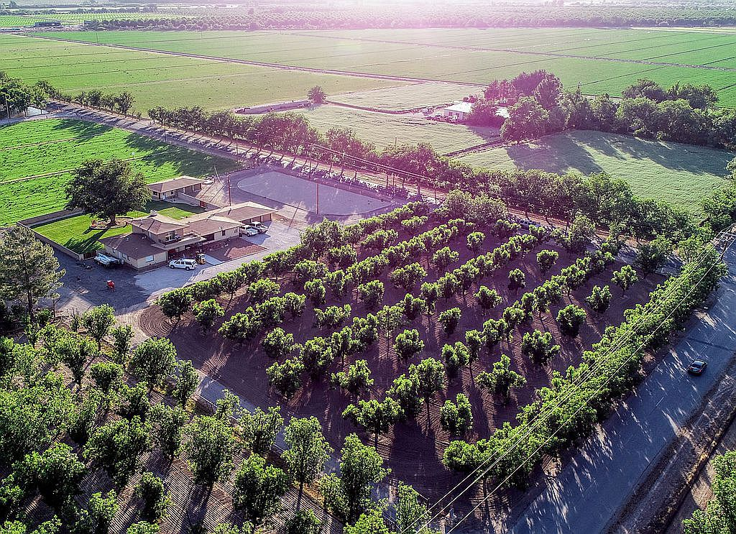
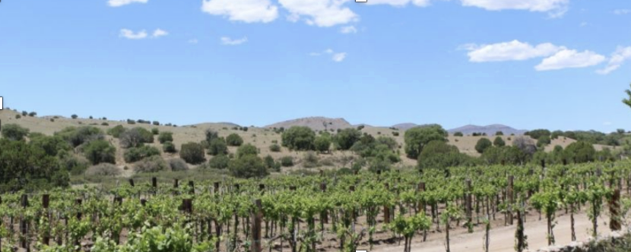
Rural Development Grants Awarded
(Las Cruces) For technology to preserve locally grown fruits and vegetables for longer periods of time. ($125K)
4 A- Packing (L.C.): to use local chile in a new product ($250K)
New Mexico Wineries in
Lordsburg to build a solar
array that generates
enough energy to power
38 homes. ($100K)

Slide 13
Rural Development Grants Awarded
To improve Anthony’s
sewer service ($5.5M)
for technical training and assistance to small rural businesses

Slide 14
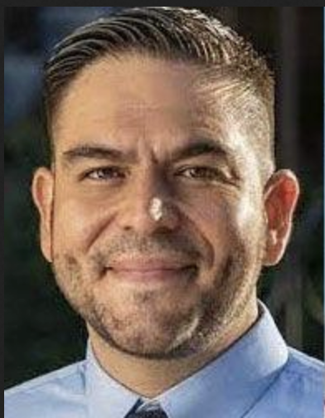
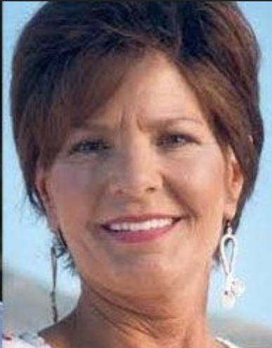
Issues in 2022
vs
Opportunity
Fear
Rural economic development
Public safety
Border = opportunity
Border = narcotics
Agriculture: immigration
Illegal immigrants
Environment/public lands
More O&G drilling
Reproductive rights
Anti-reproductive rights

Slide 15
= introduced by Rep. Vasquez
(would not exist without him)

Slide 16
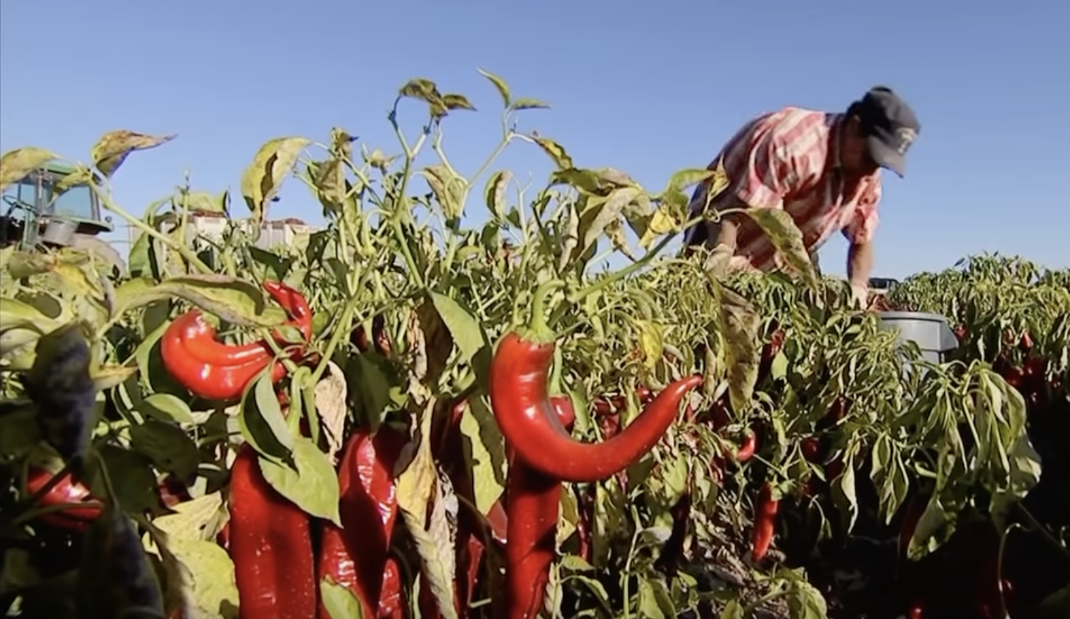
Bipartisan Farm Workforce Support Act
Agriculture & Immigration
Rural economic development
Paves a path to H-2A visa reform (temporary agric. workers)
Ensures we have a workforce on our farms
Ensures fair wages & decent housing for farmworkers

Slide 17
Economic Opportunity for Border Communities Act
The Border
Rural economic development
A national strategy to increase the number of jobs in border communities
In 2020, Santa Teresa Port & Industrial Parks created 6,000 jobs, had $1 billion output, paid $26 million in taxes

Slide 18
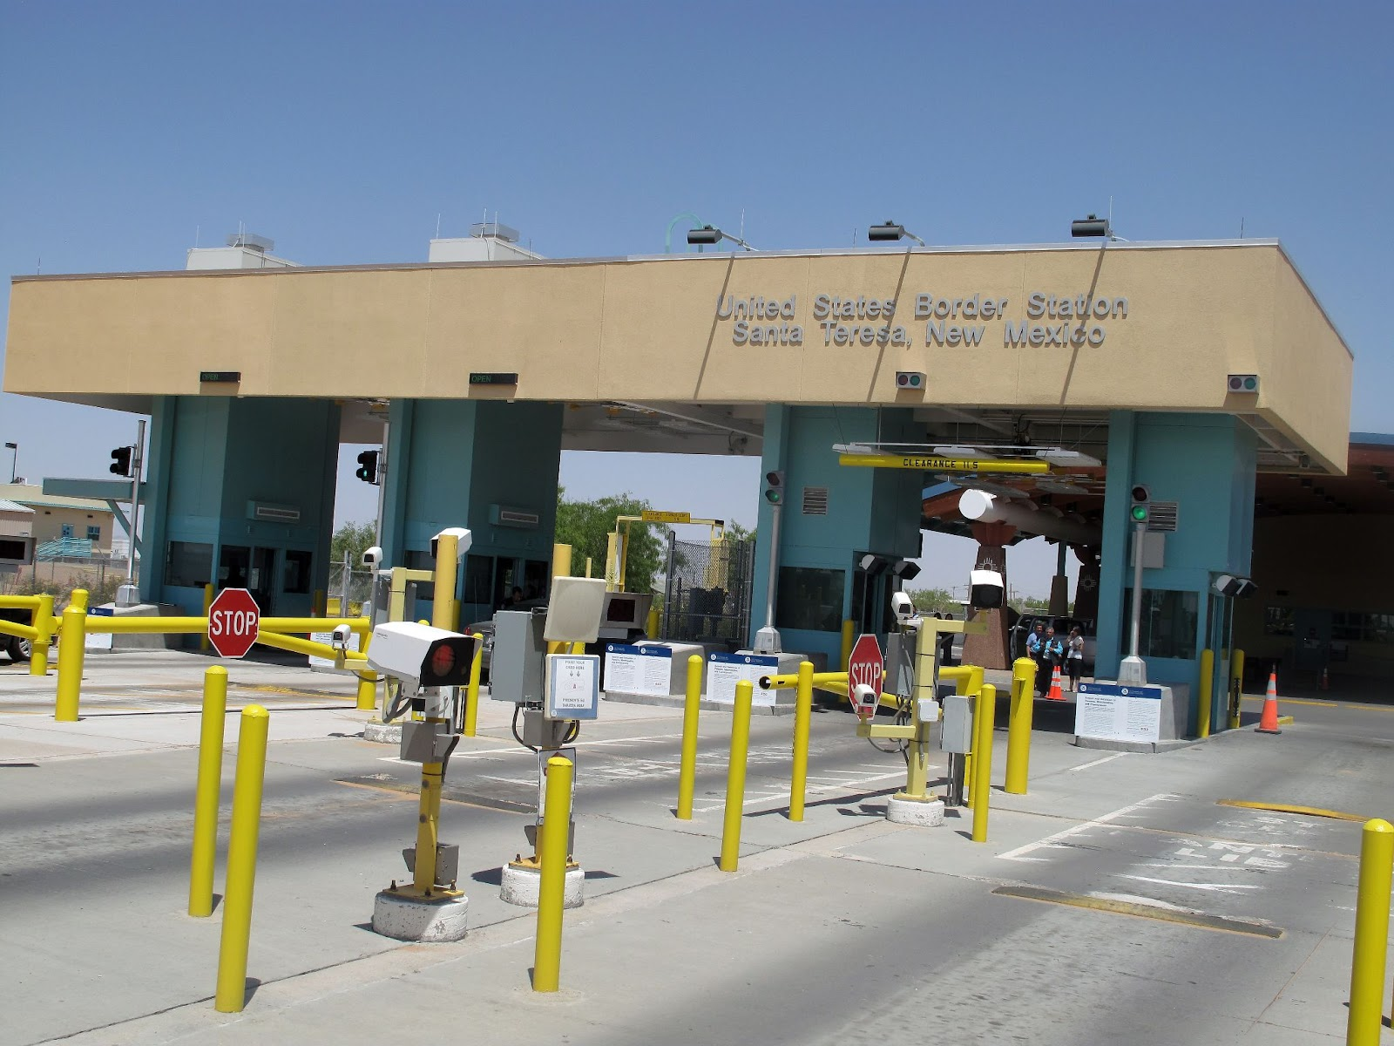
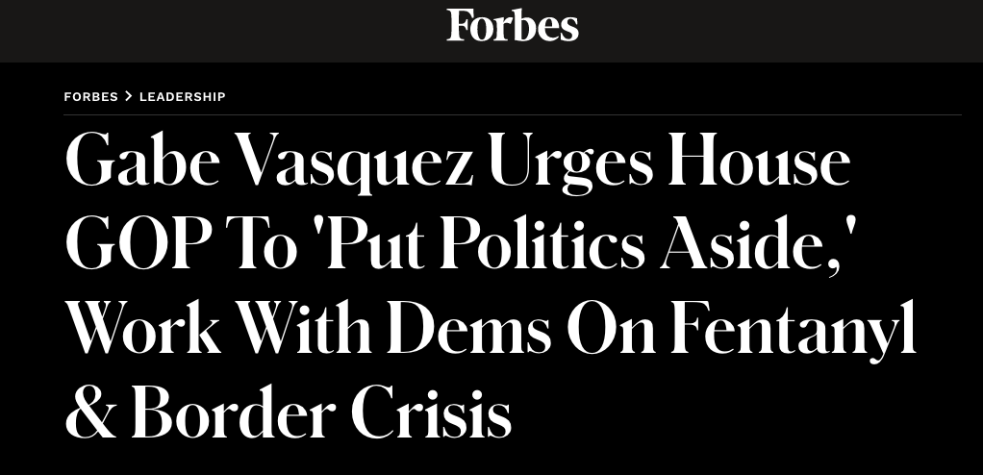
Joint Task Force to Combat Opioid Trafficking Act
This bipartisan bill authorizes the Dept. of Homeland Security to create a Joint Task Force to improve border security to prevent narcotics from being smuggled into the United States.
The Border
Narcotics

Slide 19
The Energy Workers Health Improvement & Compensation Fund Act
Oil & Gas
Requires record profit-making O & G executives to contribute to a fund to cover health care expenses for workers & their families for work-related illnesses
Ensures the well being of NM’s energy workers while protecting NM’s long-term economic prospects.
Local energy workers and Somos Un Pueblo Unido partnered with Rep. Vasquez to create this fair compensation proposal.
Rural economic development

Slide 20
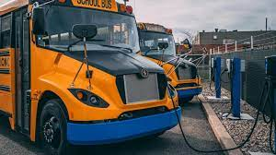
Community Facilities Program for Rural Clean School Bus Infrastructure Act
The EPA is giving electric school buses to four communities in NM (Las Cruces is one of them). But the buses don’t come with the charging technology they need. This bill lets them buy the charging technology with USDA grant or loans.

Slide 21
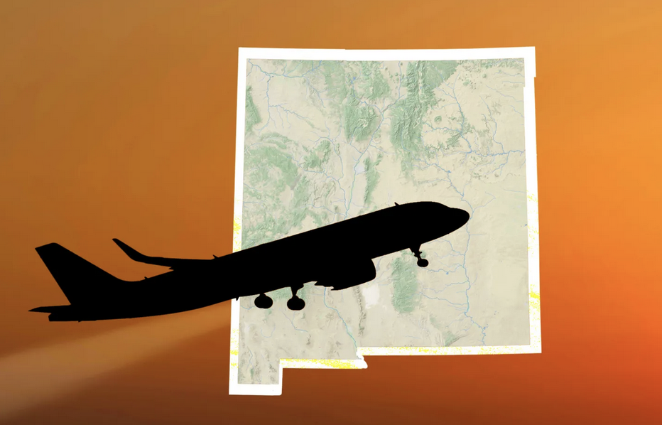
Restoring air service to rural communities and funding regional airports
FAA Reauthorization includes Vasquez Amendment:
Re-opening of Alamogordo-White Sands Airport to be studied
Vasquez introduced Expanding Regional Airports Act to provide federal funds for regional airports:
Las Cruces to Albuquerque flight restored
Rural
Economic
Development

Slide 22
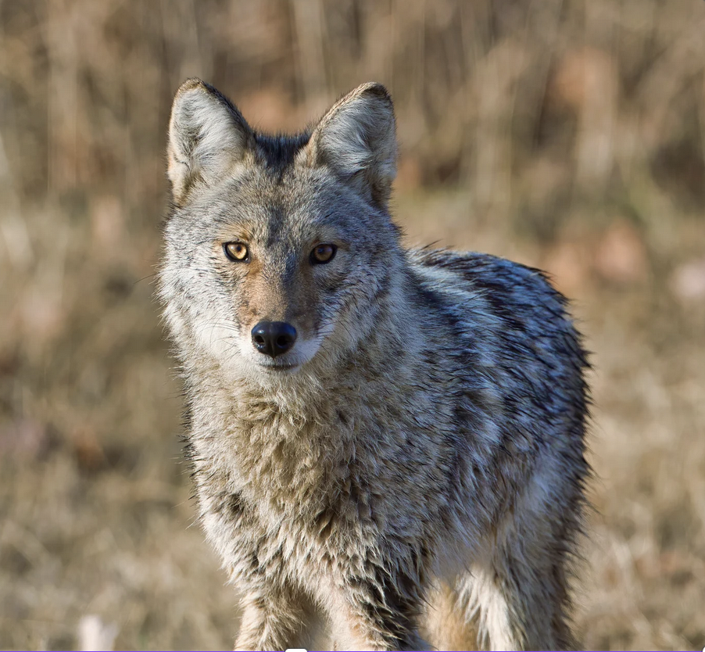
Wolf and Livestock Fairness (WOLF) Act
The gray wolf in New Mexico and Arizona is a federally protected endangered species.
This bill increases compensation
for ranchers to 100 percent of
the value of cattle loss and compensates them for decreased herd sizes. (They are currently compensated at 75 percent.)
Rural economic devpt

Slide 23
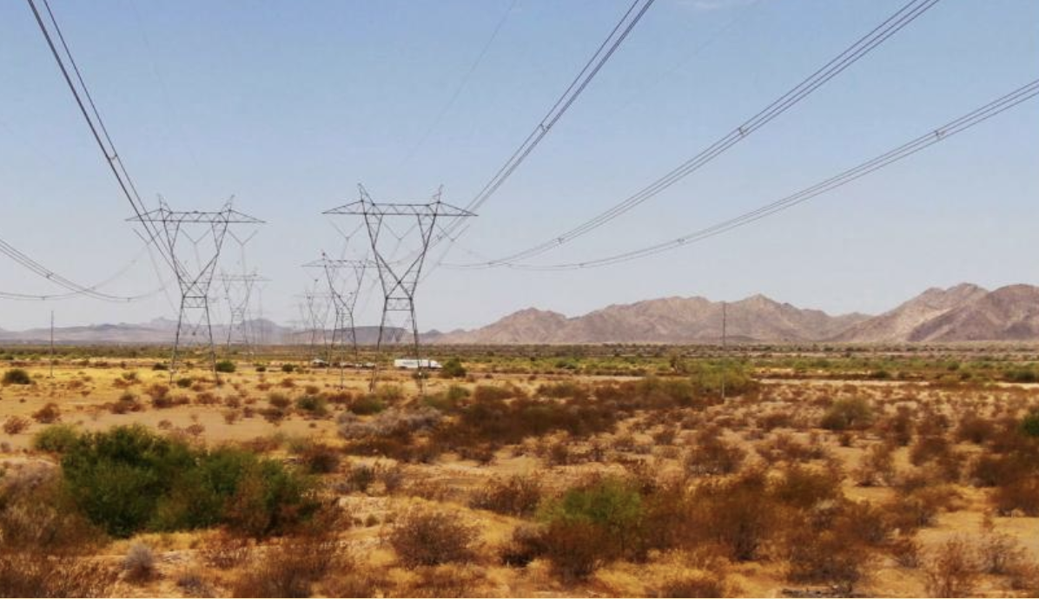
Environment + Serving Constituents
Providing federal
dollars for
workforce
training and
infrastructure
for SunZia Wind &
Transmission for
renewable
energy for NM &
Arizona
Partnering with Mescalero Apache tribe to protect Otero Mesa
Keeping open the Grapevine Campground in the Gila Wilderness
Rural economic devpt

Slide 24
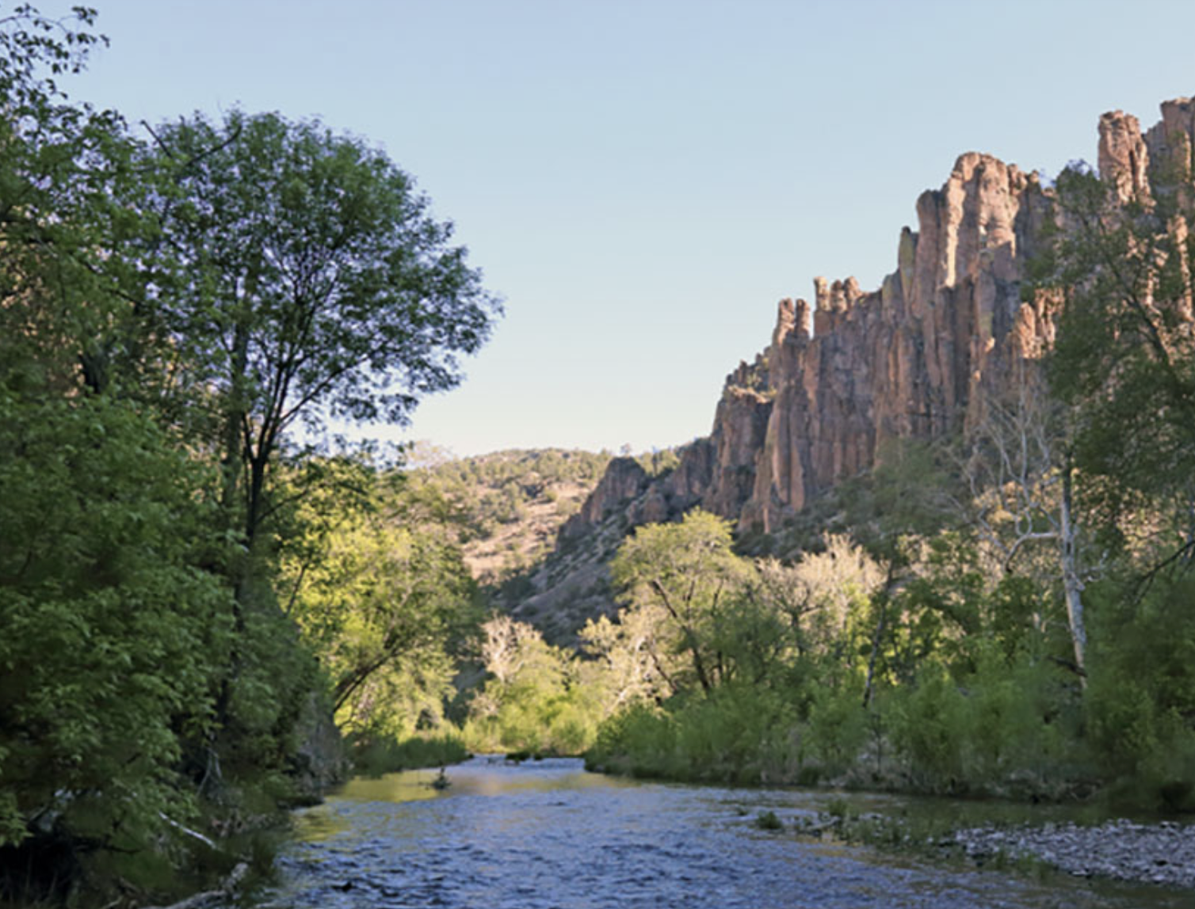
Protecting the Gila River & Wilderness
M.H. Dutch Salmon
Greater Gila Wild
and Scenic River Act
(House version of
Sen. Heinrich’s bill)
Designates parts of the Gila as Wild and Scenic for recreational and agricultural economies that rely on it.
Rural economic devpt

Slide 25
National Defense Authorization Act Vote
MAGA Republicans added culture war items to a bill that provides military spending for the nation:
It rescinded reimbursing travel for abortion
It rescinded access for transgender care
It rescinded diversity, equity & inclusion initiatives at the Pentagon
There are 2 military bases, Holloman Air Force Base and White Sands Missile Range Army Base, in CD-2
The House bill is not final. The Senate will create their own version and there will be a reconciliation vote merging the two bills.

Slide 26
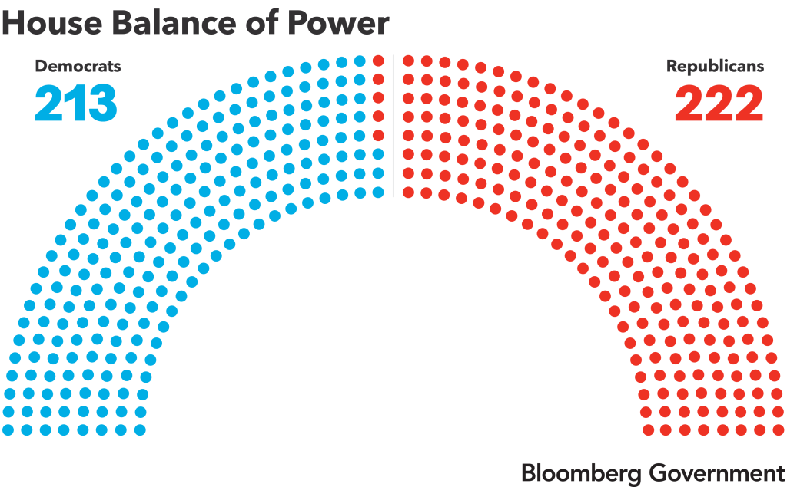
Rep. Vasquez is one of Republicans’ top 5 targets
Imagine the ads that would target Rep. Vasquez if he voted against defense spending authorization.

Slide 27
How would you vote?

Slide 28
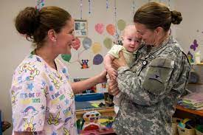
Rep. Vasquez voted for the NDAA after adding dozens of provisions to the bill including:
military base childcare expansion

Slide 29
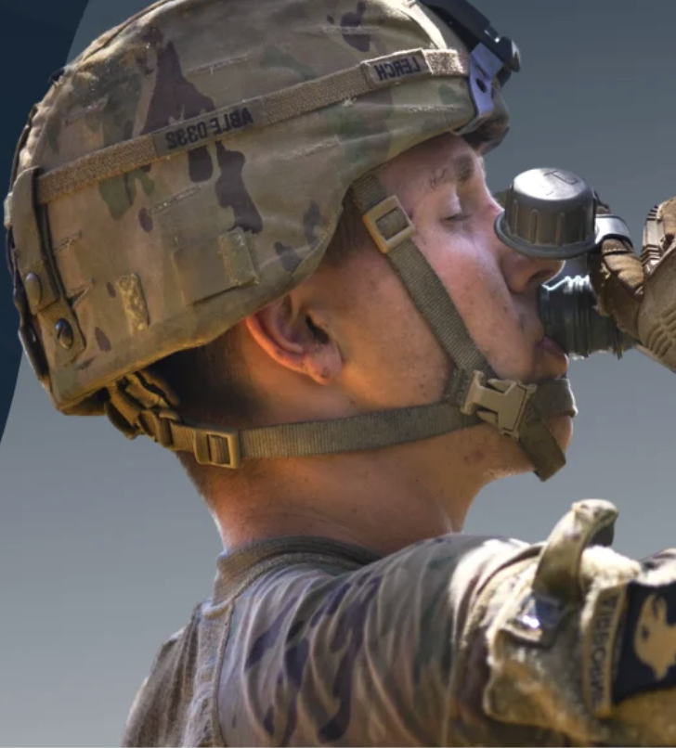
Rep. Vasquez voted for the NDAA after adding:
A mandate that requires
military base water quality reports and Dept. of Defense report on PFAS contamination in drinking water around military institutions.
PFAS = “forever chemicals,”
a big issue at Holloman Air Force Base.

Slide 30
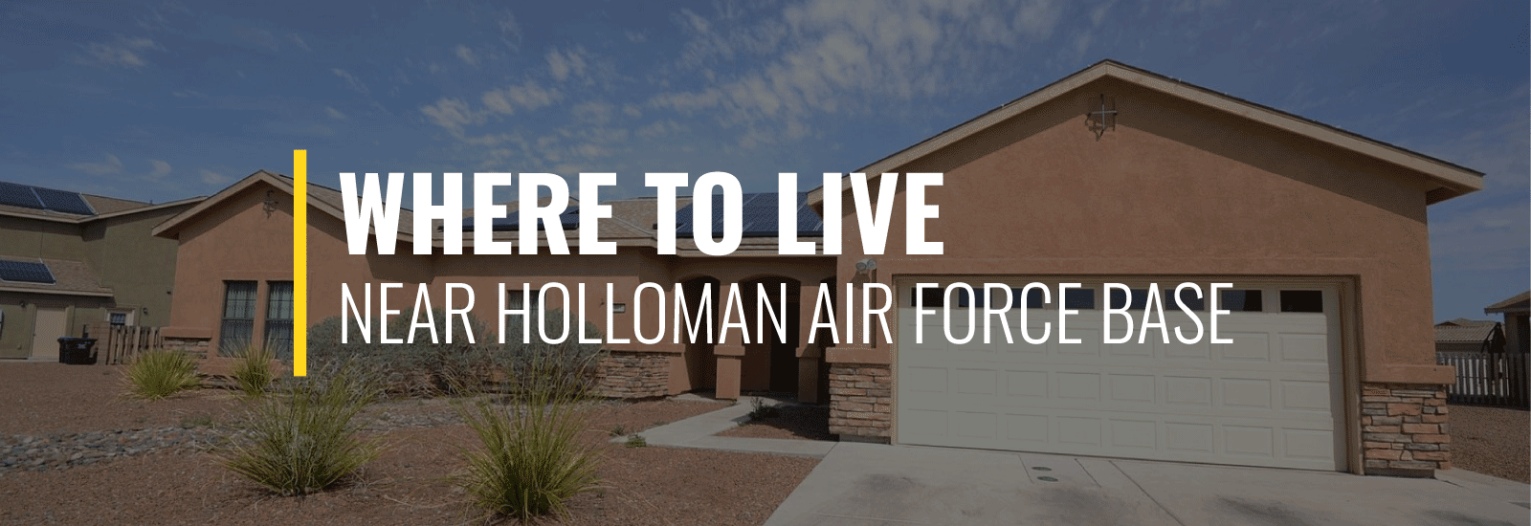
Rep. Vasquez voted for the NDAA after adding:
a provision in the bill to prioritize building and modernizing housing at places like White Sands Missile Range, rather than just issuing waivers for insufficient housing.

Slide 31
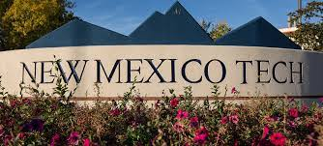
Rep. Vasquez voted for the NDAA after adding:
a provision to increase opportunities for the Air Force to partner with academic institutions, like NM Tech, for cyberspace training and operations.

Slide 32
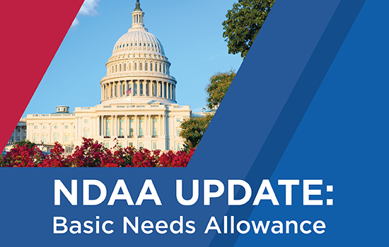
Rep. Vasquez voted for the NDAA after voting to include:
a 5.2 percent pay raise for service members.

Slide 33
Other Votes for House Bills
Votesmart.org

Slide 34
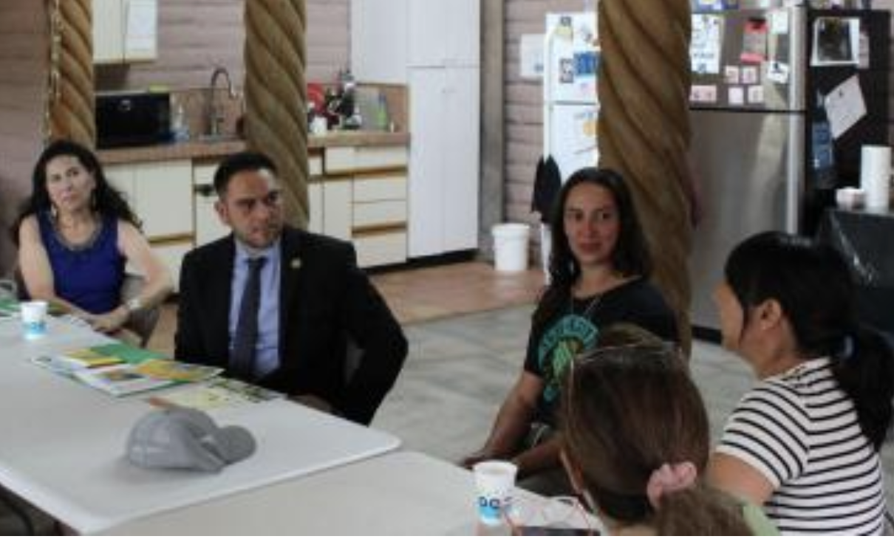
Farm Bill
Serving on the Agriculture Committee, Rep. Vasquez meets with stakeholders to ensure the bill:
Provides for voluntary conservation to keep more of NM’s water in the ground
Promotes rural development such as farm worker housing
Gets arsenic and lead out of wastewater systems
Makes sure systems that help put food on the table have what they need.
Provides food security (SNAP, TEFAP, WIC).

Slide 35
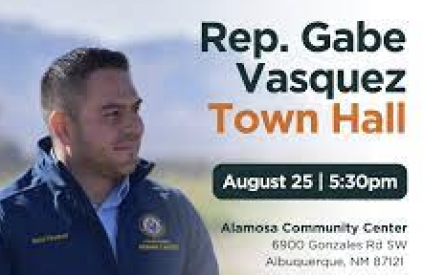
Constituent Services & Town Halls

Slide 36
Democratic values + effectiveness
“I’ve looked above the party politics to serve New Mexico while holding tight to my Democratic values. … We need to have compromise but we also need to have those strong Democratic values like:
protecting women’s health care
supporting immigration reform
protecting our LGBTQ community
growing good jobs
protecting students to get an education …
as well as workforce and occupational training.”
–Rep. Gabe Vasquez

Slide 37
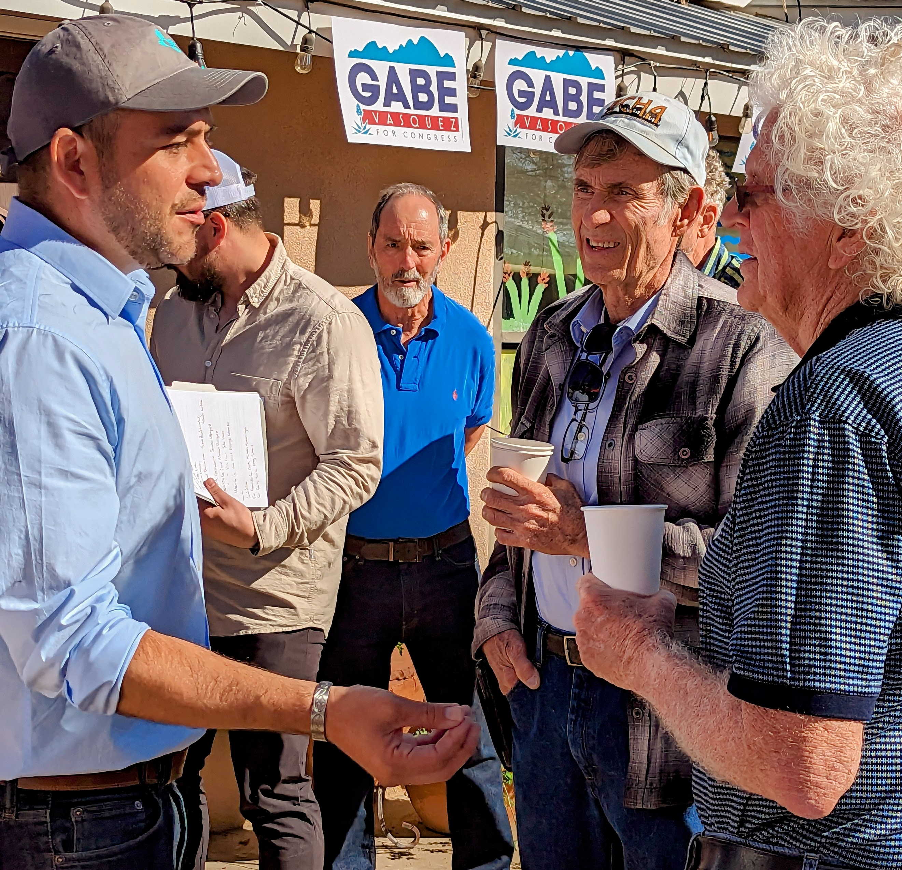
Democratic values + effectiveness
“My Democratic values are what I will always lead with, while making sure that, while I’m here, I’m going to be effective and I’m going to be somebody that folks can trust.”

Slide 38
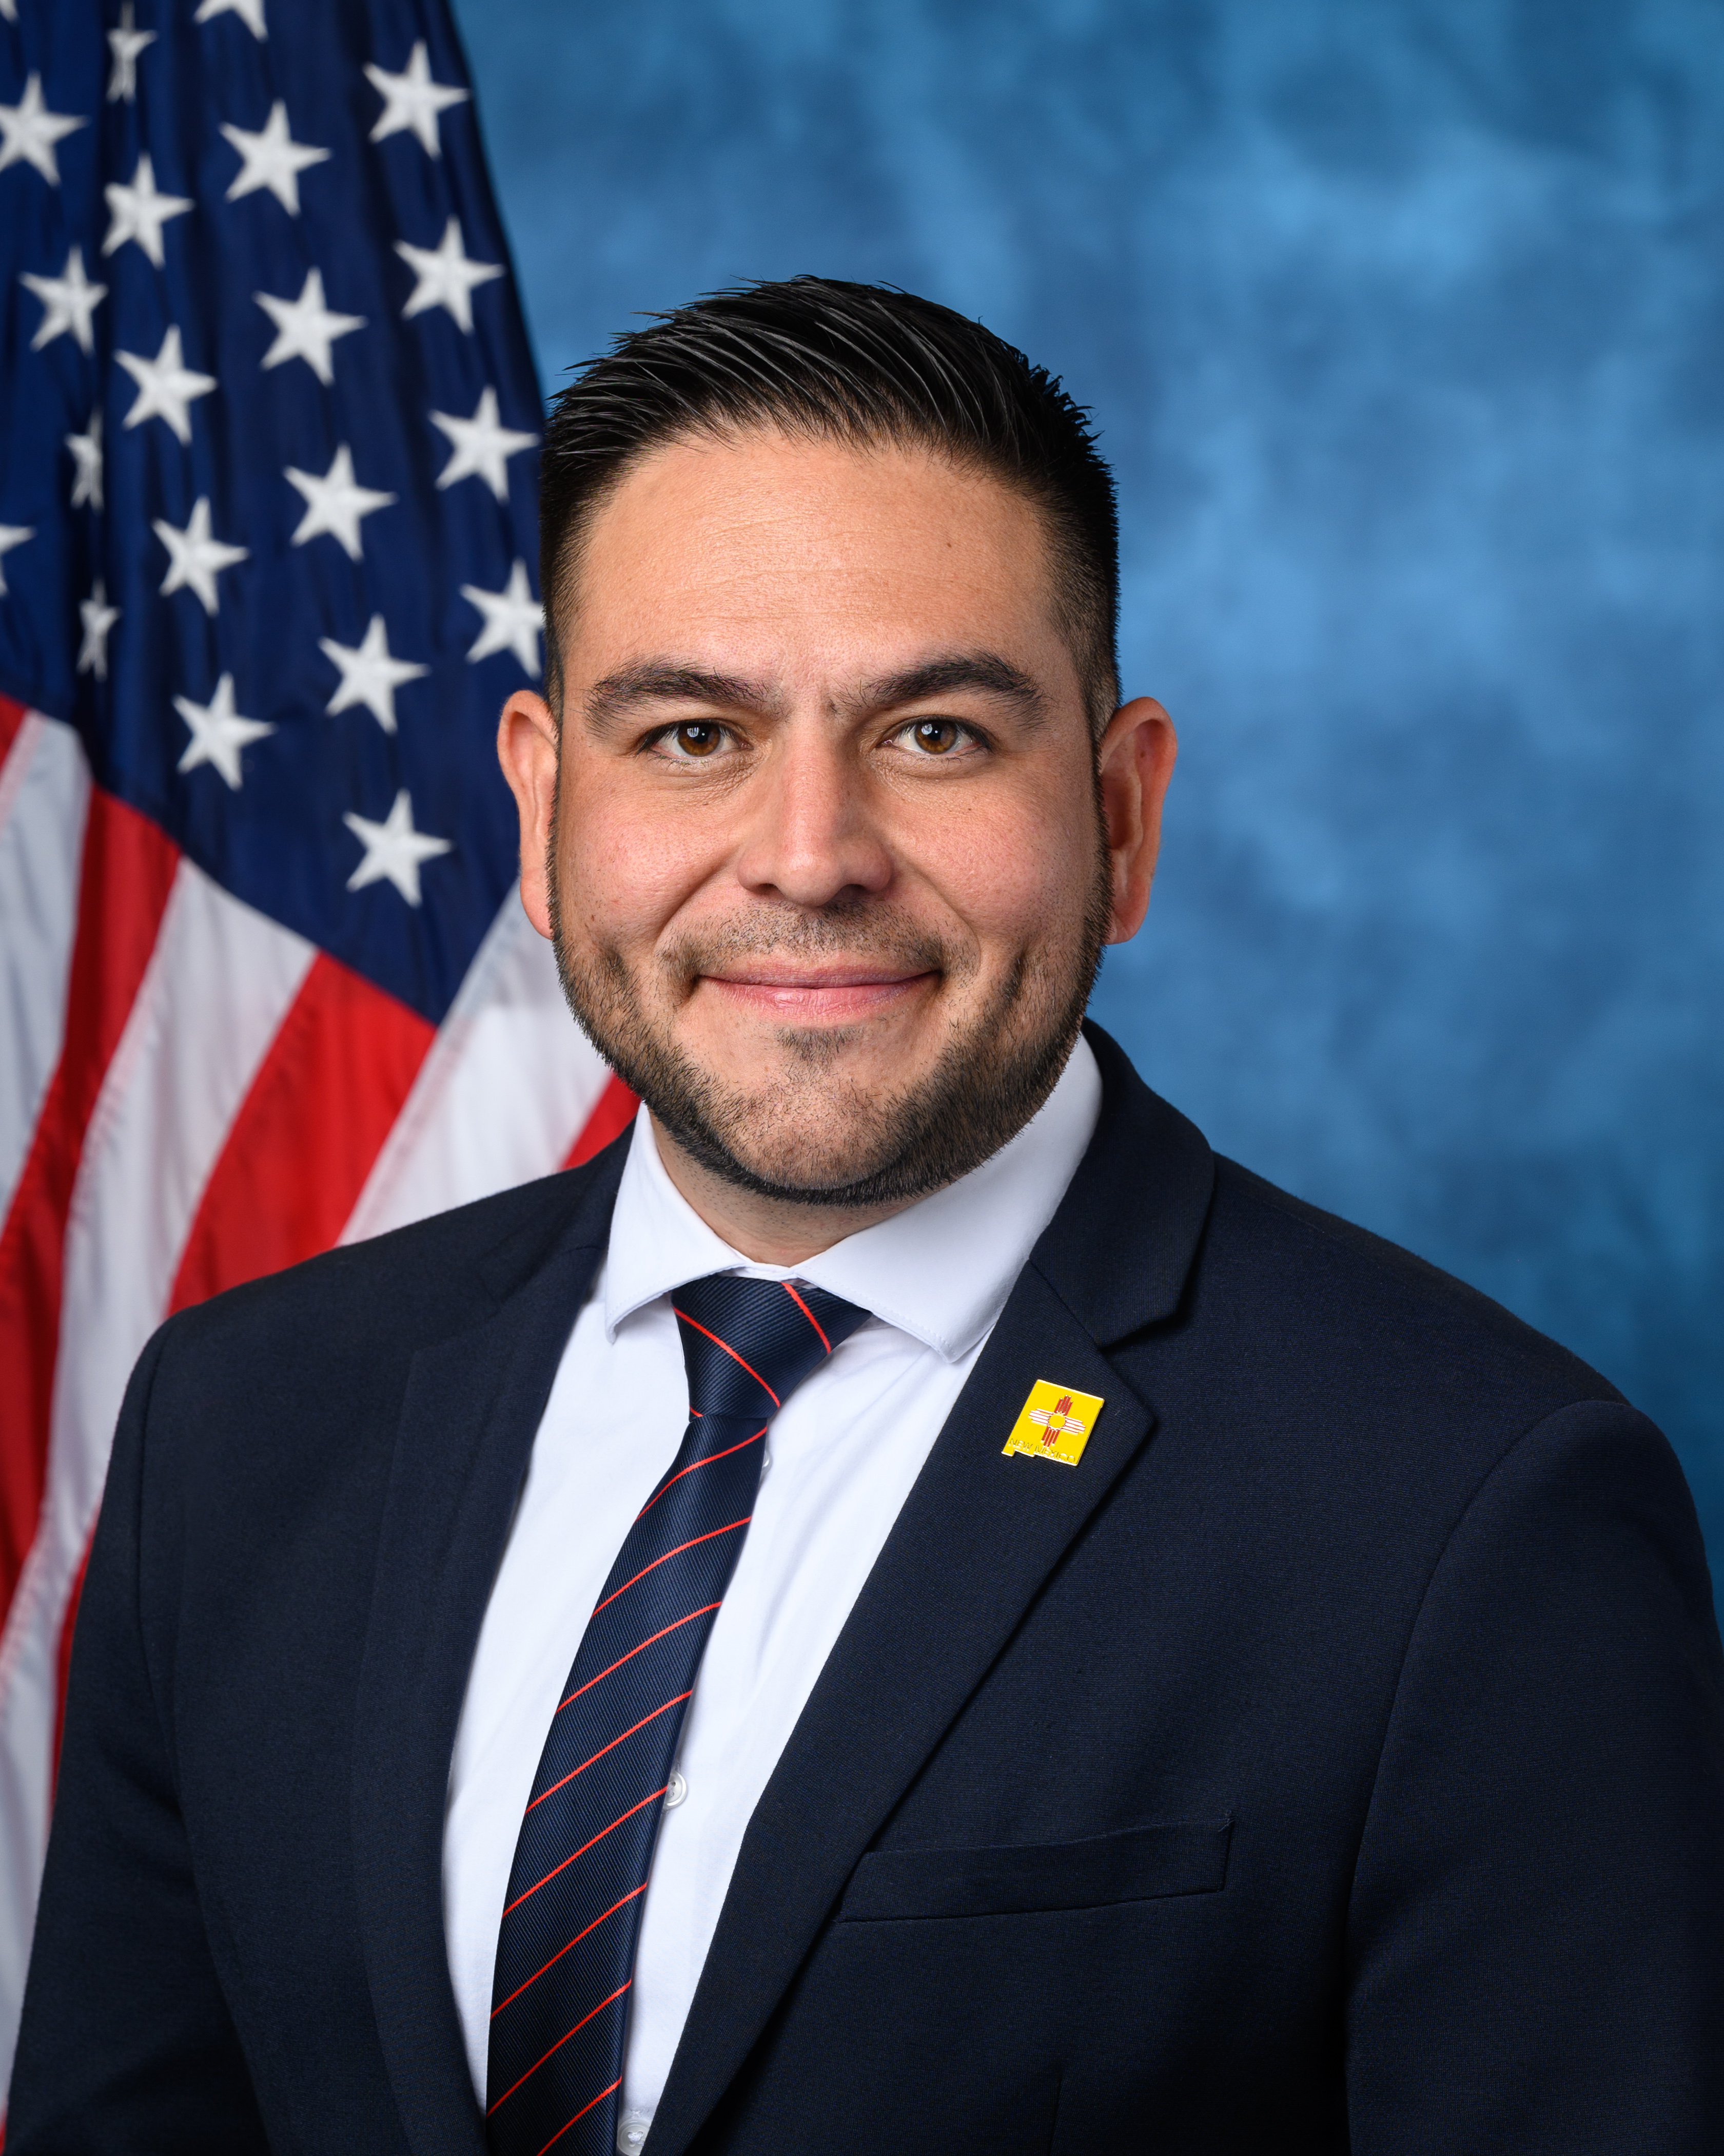
Get louder. Get prouder.
Provided Community Funding
Tackled every major issue with practical and, when possible, bipartisan proposals
Knowing NDAA would pass in a changed form, added value to it
Stands up for Democratic values

Slide 39
New Voices. New Voters. New Mexico.
www.bluecd2nm.com

